Slide 1
Web Programming Final Project
16040054 고용기

Slide 2
Place Record Site
Sharing the information by recording the place in Web Site.(restaurant, good place).
The information you write is stored in google firebase db.
The data stored in the db is shown in the html table.
If you want to delete the information you have created, press the remove button to delete it from the DB.
api used google firebase, google maps.

Slide 3

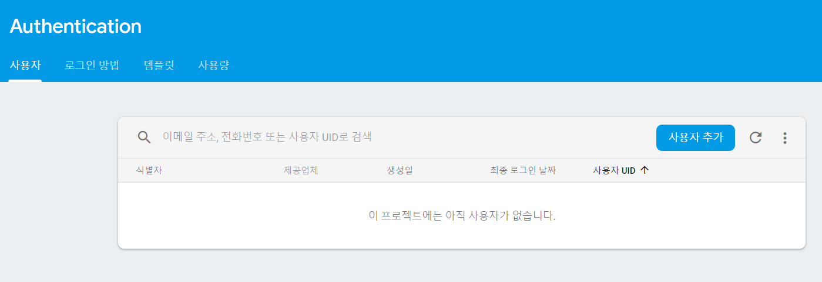
Step 1 : Created Your ID & Password
You must log in to record the place.
Do not worry. Create your ID in email format, create a password, and click the sign-up button to log in.

Slide 4
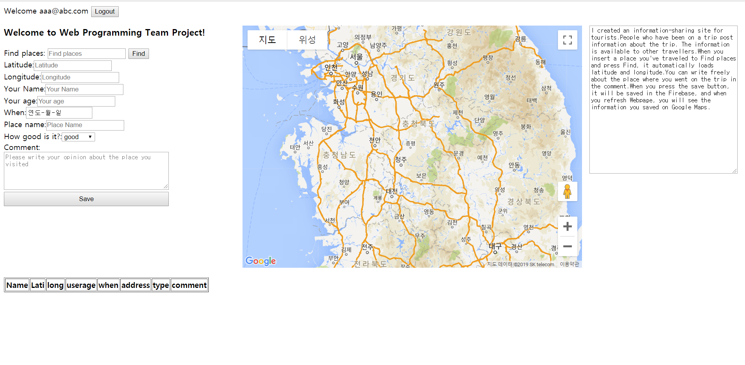
Step 2 : Place Record

Slide 5
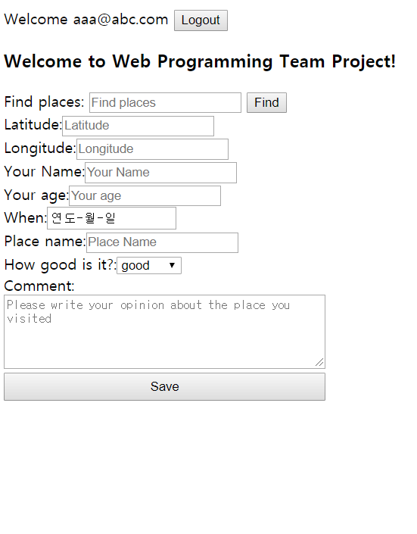
Step 2 : Place Record
Find places : Once you enter a place, you can see it on google maps.
Latitude,Longitude : When you click on Google Maps, it brings up the latitude and longitude of the clicked point.
When : The day you visited the place
How good is it? : Please fill out the satisfaction level for the place you visited.
Comment : Fill out your opinion about the place.
Save : Click to save the information to firebase db.

Slide 6
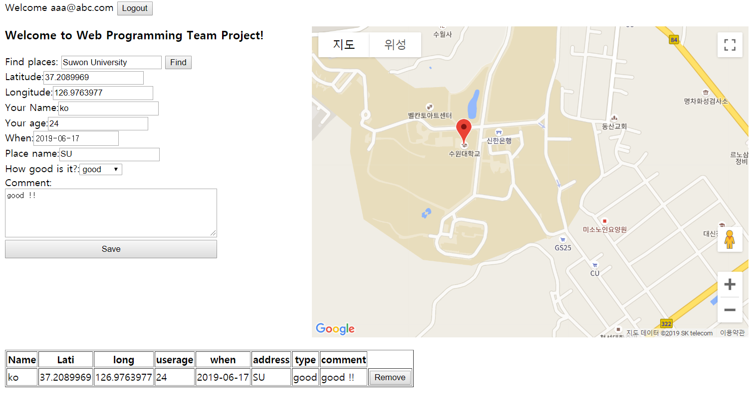
Result

Slide 7
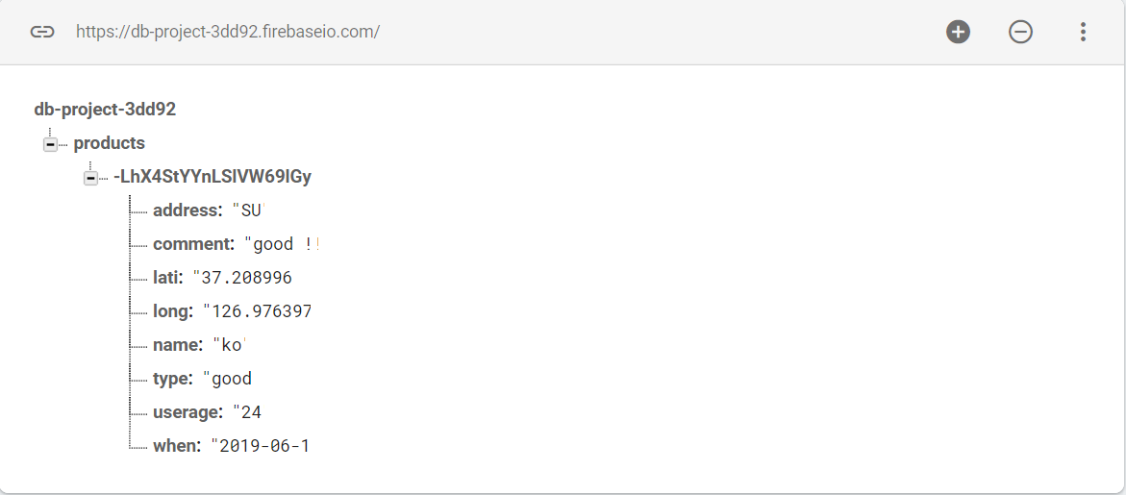
Google fb db

